Slide 1
IN723 MPLS
MPLS – LDP

Slide 2
Resources
What is a VPN
http://www.cisco.com/c/en/us/about/press/internet-protocol-journal/back-issues/table-contents-18/what-is-a-vpn.html
MPLS FAQ for beginners
http://www.cisco.com/c/en/us/support/docs/multiprotocol-label-switching-mpls/mpls/4649-mpls-faq-4649.html
Configure a basic MPLS VPN
http://www.cisco.com/c/en/us/support/docs/multiprotocol-label-switching-mpls/mpls/13733-mpls-vpn-basic.html

Slide 3
What is a VPN?
Virtual Private Network
Network connection between devices that do not literally share a physical cable
Examples:
– Layer 2 VPNs
Ethernet VLANs
Frame Relay & ATM PVCs
– Layer 3 VPNs
GRE Tunnel
IPSec Tunnel
MPLS VPN

Slide 4
VPN Categories
Depending on the service provider's participation in customer routing, the VPN implementations can be classified broadly into one of the following:
Overlay model
Peer-to-peer model

Slide 5
Overlay Model
Examples - Frame Relay, ATM, Tunnelling (GRE, IPsec)
Provider does not participate in customer routing
Intermediate link-layer network is used as a "cut-through" to another edge node on the other side of a cloud
Scalability & complexity issues

Slide 6
Peer-to-peer Model
The service provider actively participates in customer routing
Provide customers with optimal data transport via the service provider (SP) backbone
Routing information is exchanged between the customer routers (CE) and the service provider routers (PE)
MPLS VPN is peer to peer

Slide 7
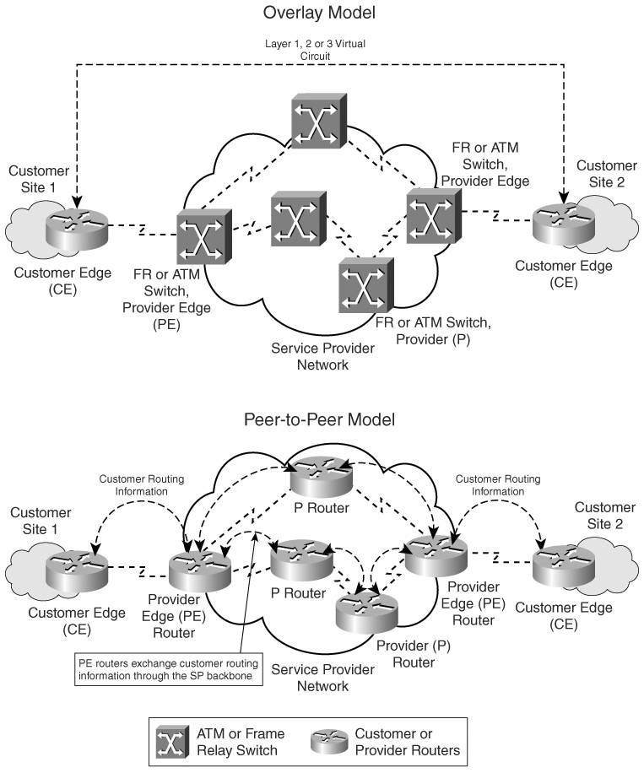
Notes:
MPLS VPN = separate routing instance (in core) per customer

Slide 8
MPLS Architecture and Terminology
CE routers: Customer edge routers in the customer network that interface with the service provider network
Provider network: Provider-controlled domain consisting of provider edge and provider core routers that connect sites belonging to the customer on a shared Infrastructure
PE routers: Provider edge routers that interface or connect to the customer edge routers in the customer network
P routers: Routers in the core of the provider network that interface with either other provider core routers or provider edge routers

Slide 9
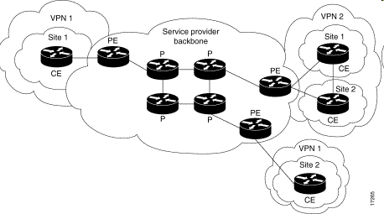
MPLS VPN

Slide 10
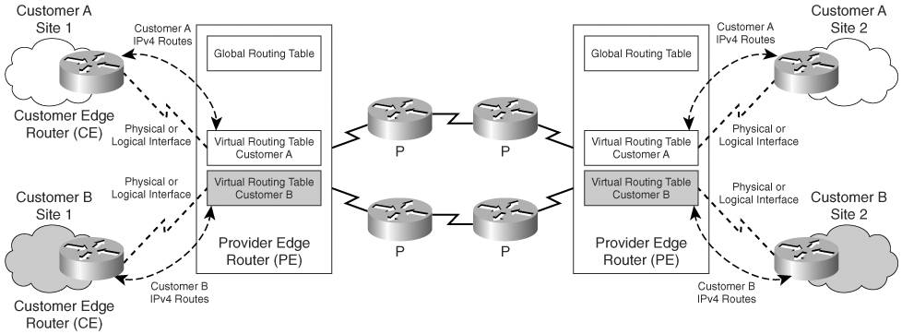
MPLS VPN Routing Model
Notes:
Summary

Slide 11
What is MPLS?
Technique for transporting data from one network node to the next based on short path labels rather than long network addresses
Avoids complex lookups in a routing table. More efficient
The labels identify virtual links (paths) between distant nodes
Notes:
Typically PE to P to PE

Slide 12
What is MPLS?
Multiprotocol Label Switching
Open standard
– RFC 3031 “Multiprotocol Label Switching Architecture”
– Previously Cisco proprietary Tag Switching
Multiprotocol
Can transport different payloads:
– Layer 2:
Ethernet
Frame Relay
ATM
– Layer 3:
IPv4
IPv6

Slide 13
What is MPLS?
Label Switching
“switches” traffic between interfaces based on locally significant label values

Slide 14
Why Use MPLS?
Transparent tunneling over SP network
– BGP free core:
Saves routing table space on Provider routers
– Offer L2/L3 VPN service to customers:
No need for overlay VPN model
Traffic engineering
– Distribute load over under utilised links
– Give bandwidth guarantees and detect
failures quickly
Notes:
It is MPLS (Labels) that allows Customer traffic to be segregated through the Provider Core
BGP free core = Only PE routers run BGP, P routers do not.

Slide 15
MPLS Applications
Virtual Private Networking (VPN)
Traffic Engineering (TE)
Quality of Service (QOS)
Any Transport over MPLS (ATOM)
Virtual Private LAN Service (VPLS) e.g. L2 ethernet
Multicast
MPLS supports these applications through a label stack comprising multiple labels

Slide 16
MPLS Terminology
Forwarding Equivalence Class (FEC) — Group of packets which are forwarded in the same manner
MPLS Label Switch Router (LSR) — Performs the function of label switching; receives labelled packets, swaps the label with an outgoing label then forwards the new labelled packet from the appropriate interface
MPLS Edge-Label Switch Router (E-LSR) — An LSR at the border of an MPLS domain.
Performs label imposition (push) then forwards packet to destination through the MPLS-enabled domain.
Performs label disposition (pop) before forwarding an IP packet outside the MPLS domain

Slide 17
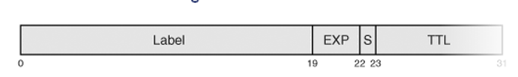
MPLS labels and label stacks— A 20 bit label value is assigned by a router to identify a prefix. Each MPLS label comprises 4 fields (totalling 32bits). Multiple labels define a label stack.
20-bit label value
3-bit experimental field
1-bit bottom-of-stack indicator
8-bit Time-to-Live field

Slide 18
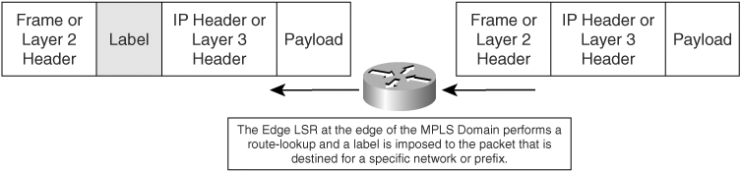
Label Imposition
Notes:
Inserted between L2 & L3 headers

Slide 19
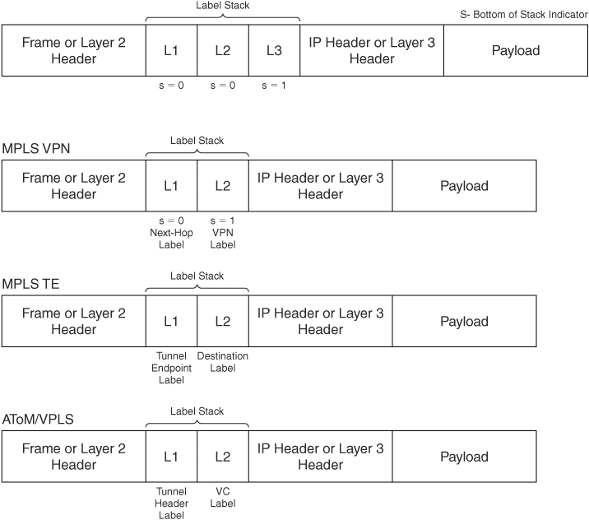
Notes:
A label stack is used to support MPLS applications
MPLS VPN with TE uses 3 label stack
The top label (L1) is used to get from the ingress PE to the egress PE.

Slide 20
MPLS label actions
Pop — Removes the top label in the MPLS label stack and propagates the remaining payload as either a labelled packet (if the bottom-of-stack bit is zero) or as an unlabelled IP packet (if bottom-of-stack is one)
Swap — Replaces the top label in the MPLS label stack with a new label. The packet is forwarded along the path associated with the new label
Push — A new label is pushed on top of the existing label, effectively "encapsulating" the packet in another layer of MPLS. This allows hierarchical routing of MPLS packets. Notably, this is used by MPLS VPNs

Slide 21
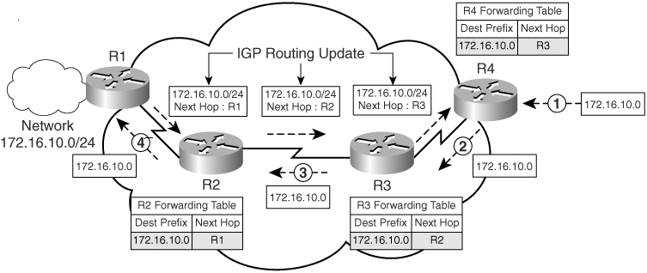
Unicast IP Forwarding in Traditional IP Networks
Notes:
Routing information (172.16.10.0/24) advertised R1 – R2 – R3 – R4
Forwarding R4 – R1

Slide 22
Overview of MPLS Forwarding
Packets are forwarded based on labels
These labels generally correspond to IP destination addresses, though can also match other parameters, such as QoS classes
Labels are generated per router and bear local significance to the router generating them
Routers assign labels to define paths called Label Switched Paths (LSP) between endpoints
Routers on the edge of the MPLS network perform routing lookups

Slide 23
MPLS Concepts
MPLS Label Switched Path (LSP)— The path from source to destination for a data packet through an MPLS-enabled network.
Upstream and downstream— Both downstream and upstream are defined with reference to the destination network / prefix. Signalling flows upstream, traffic flows downstream towards the destination.

Slide 24
MPLS Forwarding
Local Label = Label assigned by local router that is advertised to MPLS peers upstream.
Outgoing Label = Label assigned by and received from downstream router. Used when forwarding packet downstream.

Slide 25
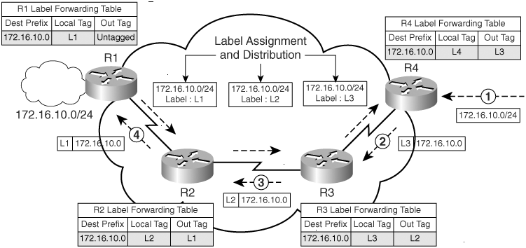
Overview of MPLS Forwarding
Notes:
Label signalling (upstream) = R1 – R2 – R3 – R4
Forwarding:
R4 receives a data packet for network 172.16.10.0 and identifies path to destination is MPLS enabled. R4 forwards the packet to next-hop Router R3 after applying a label L3 (from downstream Router R3) on the packet and forwards the labeled packet to R3.
R3 receives the labelled packet with label L3 and swaps the label L3 with L2 and forwards the packet to R2.
R2 receives the labelled packet with label L2 and swaps the label L2 with L1 and forwards the packet to R1.
R1 is the border router between the IP and MPLS domains; therefore, R1 removes the labels on the data packet and forwards the IP packet to destination network 172.16.10.0.

Slide 26
Label Distribution Options
How labels are advertised upstream
LDP – label distribution protocol (our focus)
TDP – tag distribution protocol, older Cisco proprietary

Slide 27
MPLS Architecture
Control plane— Performs functions related to identifying reachability to destination prefixes e.g OSPF, BGP, LDP
Data plane— Performs the functions relating to forwarding data packets

Slide 28
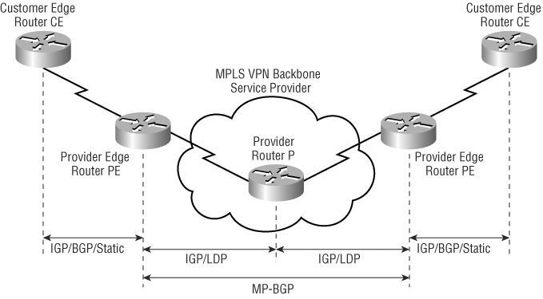
MPLS VPN Control Plane Overview
Notes:
Labels isolate VPN traffic through the SP core
PE = edge LSR
P = LSR

Slide 29
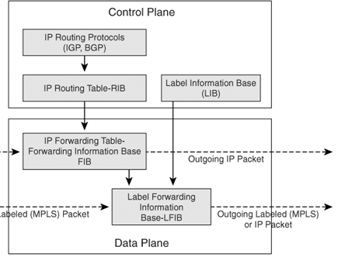
MPLS Control and Data Plane

Slide 30
MPLS Control and Data Plane
CEF is a prerequisite to implement MPLS on all Cisco platforms
The LIB is used by the label distribution protocol where IP destination prefixes in the routing table are mapped to next-hop labels that are received from downstream neighbors, as well as generated locally
The LFIB contains a local label to next-hop label mapping along with the outgoing interface, which is used to forward labelled packets

Slide 31
Control & Data Plane
RIB = show ip route
FIB = show ip cef
LIB = show mpls ldp bindings
LFIB = show mpls forwarding-table

Slide 32
MPLS Label Distribution with LDP
A label is assigned to a destination prefix found in the FIB, and it is distributed to upstream neighbor LSRs
Labels of local significance on the router are exchanged with adjacent LSRs during label distribution
Label binding of a specific prefix to a local label and a next-hop label (received from downstream LSR) is then stored in the LFIB and LIB structures

Slide 33
Penultimate Hop Popping (PHP)
The router upstream to the Edge LSR removes the top label in the label stack and forwards the resulting labelled or IP packet to the Edge LSR
This process is signalled by the downstream Edge LSR during label distribution with LDP
The downstream Edge LSR distributes an implicit-null (POP) label to the upstream router, which signals it to pop the top label in the label stack and forward the resulting labelled (VPN) or IP packet

Slide 34
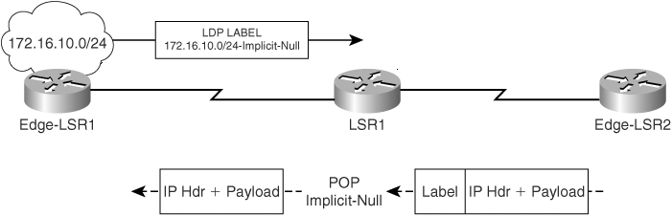
Penultimate Hop Popping
Increases performance by saving a lookup on the edge router

Slide 35
Special Outgoing Label Types
Untagged
Incoming MPLS packet converted to an IP packet and forwarded to destination (MPLS to IP Domain transition)
Implicit-null or POP label
Label assigned when top label of incoming MPLS packet is removed and the resulting MPLS or IP packet is forwarded to the next hop downstream router
Explicit-null Label
Label assigned to preserve the EXP value (QOS marking) of the top label of an incoming packet. The top label is swapped with a label value of 0 and forwarded as an MPLS packet to the next-hop downstream router. This label is used in the implementation of QoS with MPLS

Slide 36
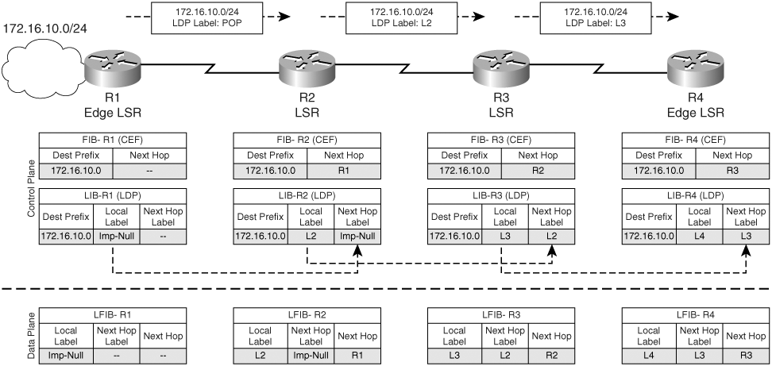
Label Assignment & Distribution
Notes:
Another view showing the control (signalling) & data planes (forwarding)

Slide 37
MPLS LDP Config
Enable CEF
Configure IGP routing protocol
Define label distribution protocol
Assign LDP router id
Configure MPLS forwarding on the interface

Slide 38
MPLS Forwarding Config
ip cef
mpls label protocol ldp
mpls ldp router-id loopback 0
interface loopback 0
ip address 10.1.1.1 255.255.255.255
interface S0/0/0
ip address 10.1.19.1 255.255.255.0
mpls ip
router ospf 1
network 10.1.1.1 0.0.0.0 area 0
network 10.1.19.1 0.0.0.0 area 0
Step 1
Step 3
Step 4
Step 5
Step 2

Slide 39
Core IGP
Cisco supports both OSPFv2 and ISIS in the MPLS provider network as the IGP
These link state protocols provide support for traffic engineering (TE)

Slide 40
Verify Basic MPLS Operation
Verify MPLS forwarding is enabled on the interfaces
show mpls interfaces
Verify the status of the Label Distribution Protocol (LDP) discovery process
show mpls ldp discovery
Verify the status of the LDP neighbor sessions
show mpls ldp neighbor

Slide 41
Verification
LFIB
show mpls forwarding-table
Local Outgoing Prefix Bytes tag Outgoing Next Hop tag tag or VC or Tunnel Id switched interface 16 16 192.168.1.97 255.255.255.255 \ 0 Se0/0.111 point2point 17 Pop tag 192.168.1.112 255.255.255.240 \ 0 Se0/0.111 point2point 18 17 192.168.1.64 255.255.255.240 \ 0 Se0/0.111 point2point 19 Pop tag 192.168.1.81 255.255.255.255 \ 0 Se0/0.111 point2point 20 18 192.168.1.33 255.255.255.255 \ 0 Se0/0.111 point2point 21 20 150.1.2.16 255.255.255.240 \ 0 Se0/0.111 point2point 22 22 150.1.2.32 255.255.255.240 \ 0 Se0/0.111 point2point
Notes:
RIB = show ip route
FIB = show ip cef
LIB = show mpls ldp bindings
LFIB = show mpls forwarding-table

